Slide 1
Lecture 18
Nick Rugai PhD

Slide 2
Class Inheritance
Inheritance is the ability to define a new class that is a modified version of an existing class.
Inheritance is a key component of Object-Oriented Programming.
Let’s play some poker!

Slide 3
Class Inheritance
There are 52 cards: Ace, 2, 3, 4, 5, 6, 7, 8, 9, 10, Jack, Queen, King.
There are 4 suits: Spades, Hearts, Diamonds, Clubs.

Slide 4
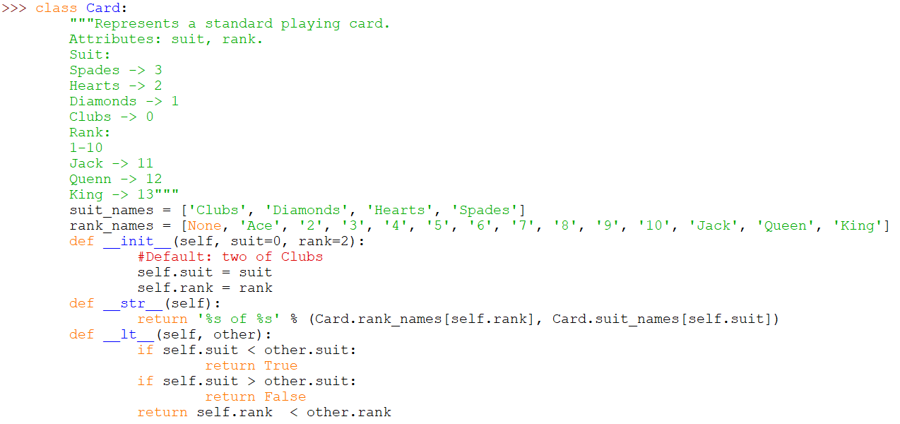
Class Inheritance

Slide 5
Class Inheritance
suit_names and rank_names are outside of any methods:
Those are Class Attributes.
suit and rank are defined inside the constructor:
Those are Instance Attributes.
Every card has it name and rank, but there is only ONE copy of suit-name and rank_name.

Slide 6
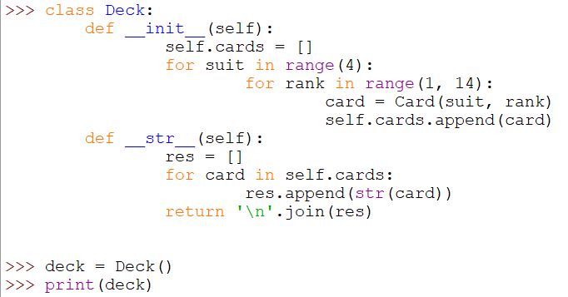
Class Inheritance

Slide 7
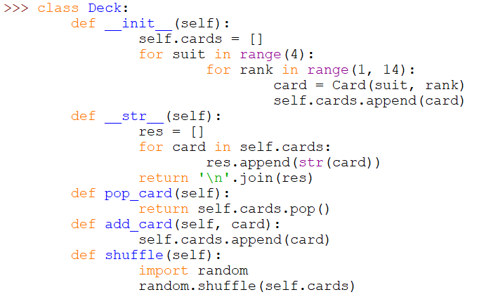
Class Inheritance

Slide 8
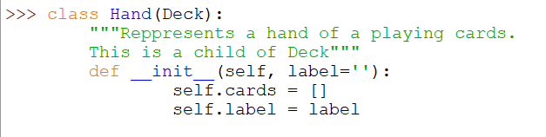
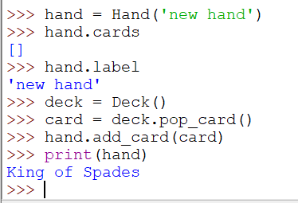
Class Inheritance

Slide 9
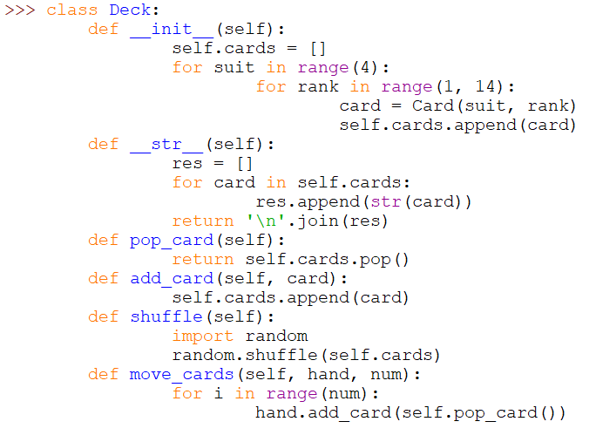
Class Inheritance

Slide 10

Class Inheritance
Such method does no do much: it goes by veneer
If one Class depends on another Class: Dependency

